Slide 1


What’s Your Mindset

Slide 2

You Can Learn Anything
https://www.khanacademy.org/youcanlearnanything
Watch this short video
This Photo by Unknown Author is licensed under CC BY

Slide 3
Growth Mindset vs Fixed Mindset
Growth
Mistakes help me improve
I can always improve-I’ll keep trying
Is this really my best work
I’m on the right track
I’m going to train my brain in math
I made a mistake
Fixed
I’ll never be as smart as her
I can’t do math
I give up
This is to hard
I can’t make this any better
It’s good enough

Slide 4
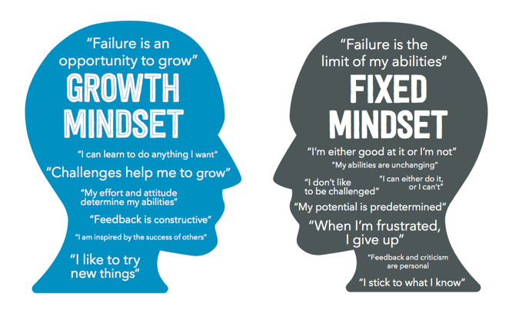
This Photo by Unknown Author is licensed under CC BY-SA-NC

Slide 5

Mistakes as Opportunities for Learning

Slide 6



Challenges
Think about some challenges in your life- something at home, school or work
Did you deal with it from a fixed mindset or a growth mindset? - Look back at the infographic and see
Why should we challenge ourselves --- to grow our brains
Lightweights will grow you muscles but the challenge of heavier weights will grow our muscles
Which is more challenging fixed mindsets or growth mindsets
This Photo by Unknown Author is licensed under CC BY-NC-ND

Slide 7
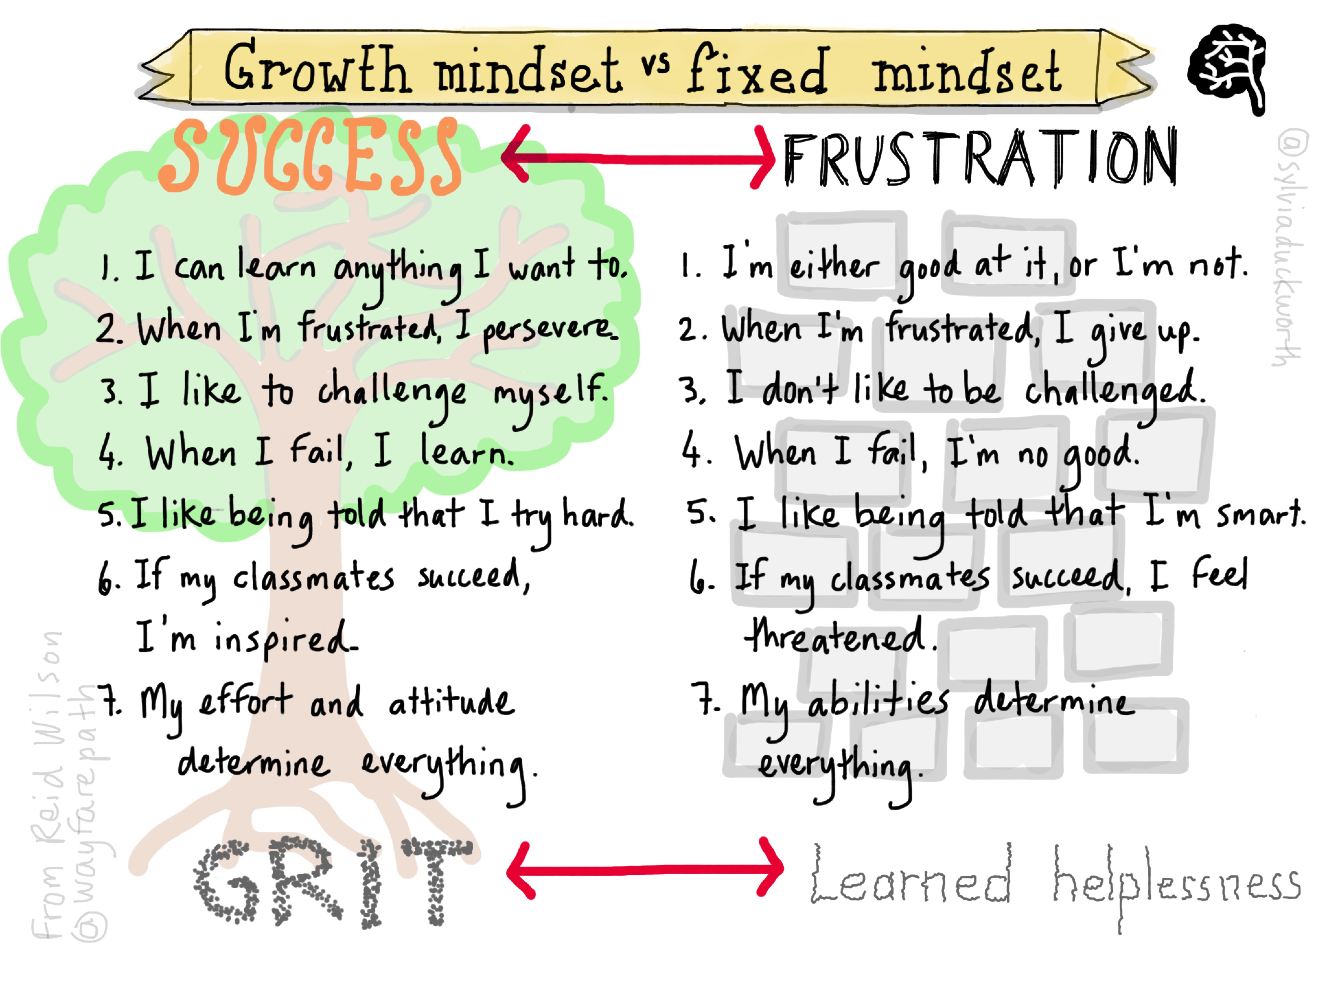
Shut down when confused? Use unsure as a reason to give up? We all have! Confusion should not be see as a read light
Confusion and feeling unsure are not stopping points. They are action indicators. That action can be to learn something new or revisit something old, to spend time reflecting, or to talk to someone.
Don’t let confusion keep you stuck. And don’t use it as an excuse to suppress feelings or thoughts.

Slide 8

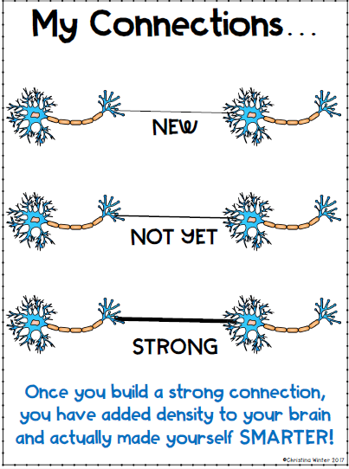
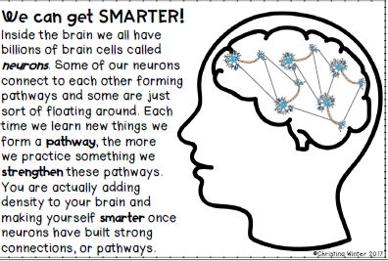
Brain Power

Slide 9
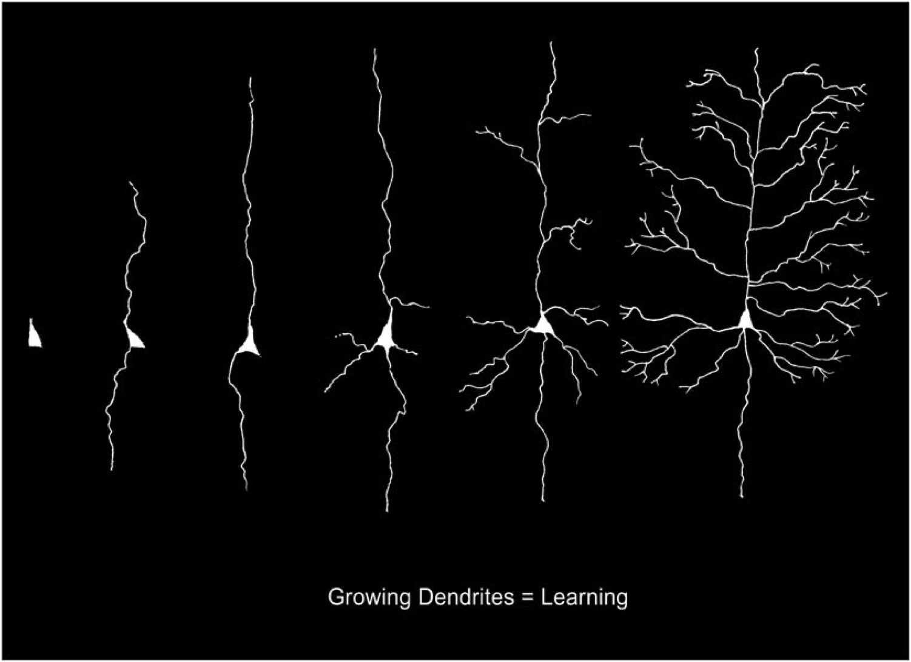
Growth Neurons=Learning

Slide 10

How Do You Grow Your Brain?
https://www.khanacademy.org/ela/cc-4th-reading-vocab/x5ea2e43787f7791b:cc-4th-growth-mindset/x5ea2e43787f7791b:building-knowledge/v/learnstorm-growth-mindset-the-truth-about-your-brain
Watch this video
This Photo by Unknown Author is licensed under CC BY-SA-NC

Slide 11
Challenge A
Choose and activity from the following slides
Follow the directions for the activity you choose.
Set a 10-minute time limit
When you are done with the challenge you chose think about these questions:
  What did you learn from today’s challenge?
  How did you keep going when you struggled?
  What steps did you take to make you successful today?
  What are some different strategies you could have used?
  If you had more time or a hint do you think you might have been able to do it?
Complete the reflection sheet: think about brain power and how your grow your brain
On your reflection sheet pick out one example of a “fixed mindset” quote and one
“growth mindset” quote. Which of the mindsets might lead to success next time and why?
Send a picture of your challenge and your reflection sheets to your google classrooms by August 17th

Slide 12
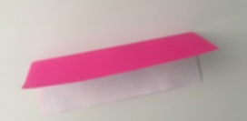
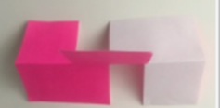
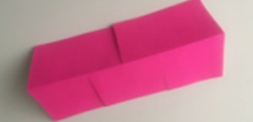
Challenge Directions
Materials: 8x10 paper and scissors
Do not spend more than 10 minutes on this challenge
Step 1: Fold paper in half
Step 2: Make cuts to the middle fold (Two on one side and one on the other)
Step 3: Twist the paper and refold as needed in the middle to finish the structure

Slide 13
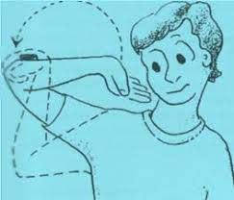
Challenge 2 Directions
Supplies: Coins and a pace to flip them
Place the coin on the back of your forearm and flip into the palm of your had.
Set a 10 minute timer

Slide 14
